Slide 1
Level FIVE project presentation;
Presented by:
Nyuykighan Jane-Mary.
Supervised by:
Mr. Njifanda Eric

Slide 2
Project Overview
This Task Management application helps to arrange and organize your affairs so you that you can have a seamless and effortless environment.

Slide 3
WORKDONE
- A simple interface that was created with the help of Python which is a high-level programming code used to write code.
-Created a database with MySQL which helped to store the information inserted.
-An Entity Relational Diagram to show the relationship between the entities in the database done with the use of Draw.io.

Slide 4
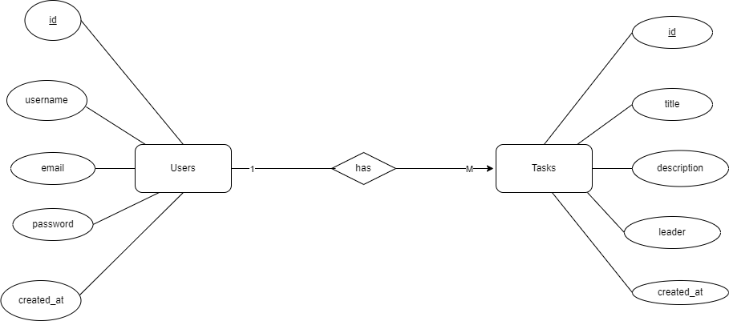
ERD DIAGRAM

Slide 5
DEMO

Slide 6
QUESTIONS

Slide 7
THANKS

